Slide 1
PySpark User Defined Functions (UDF)
Jeremy Ruebush, Alex Berryhill, Alec Day

Slide 2
What is a User Defined Function?
A User-Defined Function (UDF) in PySpark is a custom function created by the user to extend Spark's built-in capabilities. It allows you to apply your own logic to DataFrame columns or Spark SQL queries, enabling operations tailored to specific requirements.
(SparkByFunctions)

Slide 3
When are UDFs necessary
PySpark comes with a large set of built-in functions for data processing, but sometimes, the available functions are not enough to handle specific business logic. User-Defined Functions (UDFs) allow users to extend PySpark’s capabilities by implementing custom logic that cannot be achieved using native Spark functions.

Slide 4
Pros and Cons for UDFs
Pros
Custom Functionality: Enables logic that wouldn’t already be available in PySpark
Code Reusability: Functions can be used across multiple dataframes
Integration with External Libraries: Enables using Python libraries like numpy and pandas in Spark.
Cons
Performance Overhead: UDFs introduce extra processing overhead
Limited Optimization: Spark’s optimizer cannot improve UDF execution
Complex Debugging: Errors inside UDFs can be difficult to trace

Slide 5
Real-World Use Cases for UDFs
Data Cleaning & Transformation
  Standardizing text
Domain-Specific Calculations
  Financial applications: Implementing custom tax calculations.
Machine Learning & Feature Engineering
  Applying transformations like tokenization
Integration with External Libraries
  Applying external APIs or business logic that isn't natively available in PySpark

Slide 6
Simple User Defined Function Tutorial

Slide 7
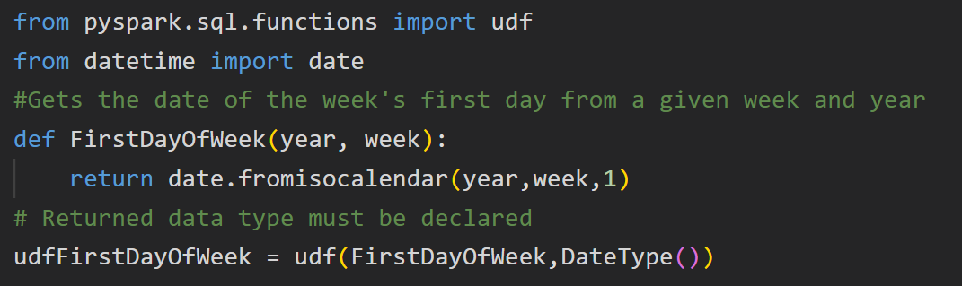
Example: Create a Pyspark UDF and register it

Slide 8
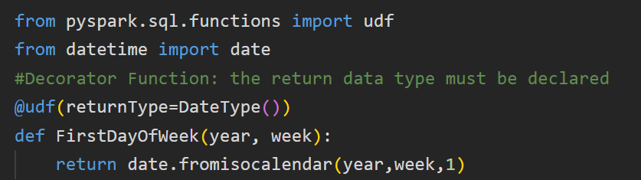
Decorator Function
In Python, the @ symbol before a function is used to denote a decorator. A decorator is a function that takes another function as an argument.

Slide 9
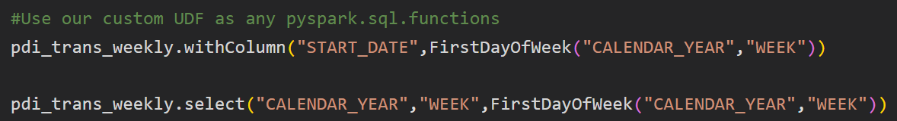
Example use: .withColumn() and .select()

Slide 10
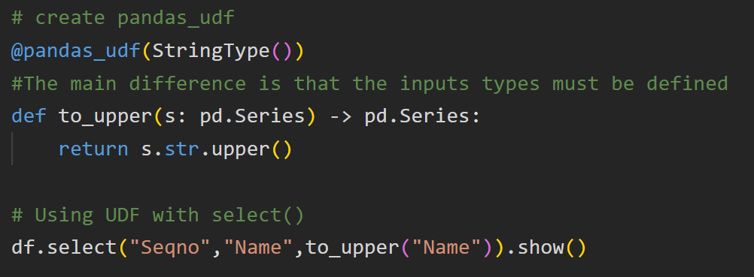
Basic pandas_UDF

Slide 11
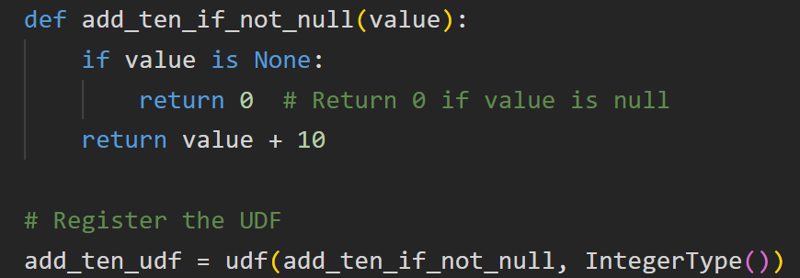
Handling Null check
UDF’s are error-prone when not designed carefully. for example, when you have a column that contains the value null on some records

Slide 12
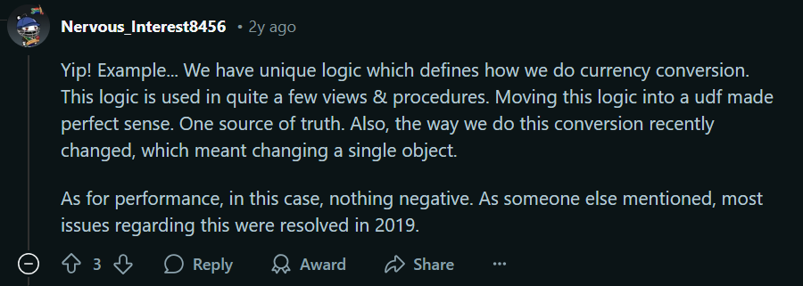
Real World Example of using a UDF

Slide 13
Pandas UDFs vs Pyspark UDFs
Pandas
Functionality with Apache Arrow
Processes data in Batches
  Operations can be applied to entire columns
Vectorized Functions
  Can operate on all elements rather than one at a time
Pyspark
Row by Row Basis
  Serialize/Deserialize
Slower with Large Datasets

Slide 14
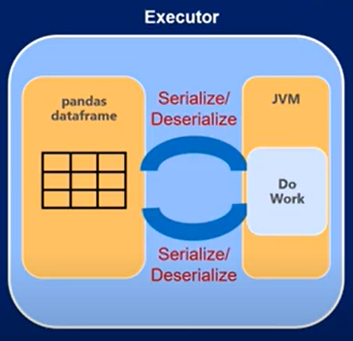
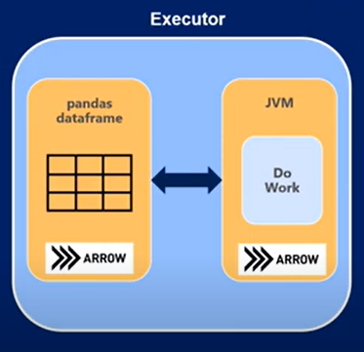
Apache Arrow

Slide 15
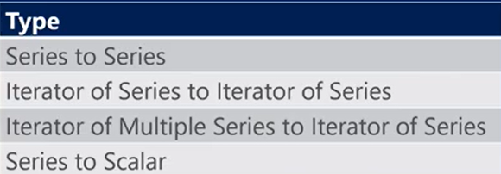
Pandas UDF: Operation Types

Slide 16
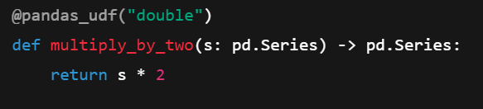
Series to Series
Takes a Pandas Series as input.
Returns a Pandas Series of the same length.
Operates row-wise on a single column, making it useful for element-wise transformations.

Slide 17
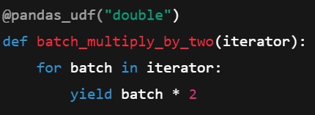
Iterator of Series to Iterator of Series
Takes an iterator of Pandas Series (batch processing).
Returns an iterator of Pandas Series.
Efficient for large datasets since it processes batches instead of single rows.

Slide 18
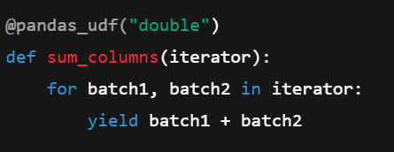
Iterator of Multiple Series to Iterator of Series
Takes an iterator of multiple Pandas Series (processing multiple columns at once).
Returns an iterator of a single Pandas Series (one column output).
Ideal for element-wise operations across multiple columns.

Slide 19
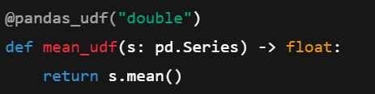
Series to Scalar
Takes a Pandas Series as input.
Returns a single scalar value (aggregation).
Used for column-wide calculations like mean, sum, min, max.

Slide 20
Code Along in Databricks

